Slide 1
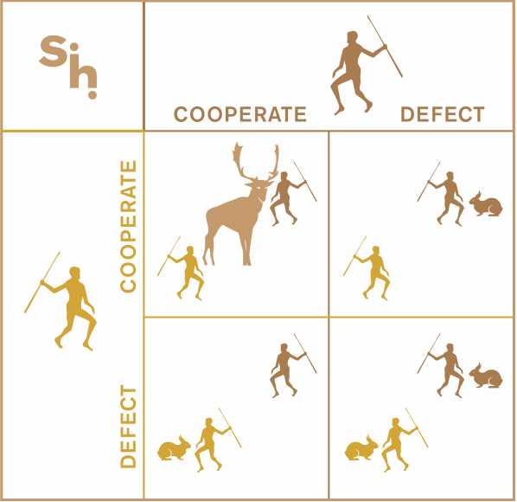
Game THEORY: STAG HUNT ANALYSIS FOR ROBOT RESCUE
Mountain Rescue Scenario
Situation: Two rescue robots discover a high-priority victim in an avalanche-prone area requiring immediate coordinated extraction.
Players & Strategies
Players: Robot A and Robot B (identical capabilities)
Collaborative Strategy (Stag): Execute synchronized dual-robot extraction
Requires precise timing and communication
Higher success rate but riskier if coordination fails
Individual Strategy (Hare): Attempt solo rescue operation
Safer, guaranteed progress
Lower success probability for victim survival
Key Challenge
The avalanche threat means robots must choose between high-reward coordination (stag) that could save the victim faster, or safe individual action (hare) with guaranteed but limited progress.

Slide 2
Payoff matrix & Strategic Analysis
Utility Function
Ui = α·Rescue_Success + β·Safety_Factor + γ·Time_Efficiency - δ·Coordination_Risk
Nash Equilibria Analysis
Payoff-Dominant Equilibrium (10,10): Both collaborate
Highest combined utility
Optimal victim survival outcome
Requires trust and communication
Risk-Dominant Equilibrium (3,3): Both act individually
Lower risk strategy
Robust against coordination failure
Suboptimal for victim but safer for robots
Strategic Insight
The game exhibits coordination dilemma: rational robots prefer mutual collaboration but may choose individual action due to coordination uncertainty.
 | Robot B cooperate | Robot B Individual
Robot A Cooperates | +10, +10 | 0, +5
Robot A Individual | +5, 0 | 3, 3

Slide 3
Practical Applications
Model Advantages
Model Limitations
Practical Implementation
Coordination Insight: Captures real cooperation dilemmas
Risk Modelling: Accounts for coordination failure costs
Strategic Flexibility: Supports both pure and mixed strategies
Scalable Framework: Adaptable to varying mission parameters
Binary Choices: Real rescue operations have continuous strategy spaces
Static Payoffs: Dynamic environment changes not captured
Perfect Rationality: Assumes optimal robot decision-making
Communication Costs: May underestimate bandwidth limitations
Trust Mechanisms: Implement reputation systems for partner reliability
Communication Protocols: Design robust signalling for coordination intention
Adaptive Thresholds: Dynamic adjustment of collaboration probability based on mission context
Backup Strategies: Graceful degradation when coordination fails

Slide 4
Critical Decision Factors
REFLECTION
Communication Quality
High-bandwidth comm: Favors collaborative strategy
Limited/noisy comm: Pushes toward individual action
Comm failure risk: Coordination cost (δ) increases dramatically
Time Pressure vs. Coordination
High urgency: May force quick individual decisions
Medium urgency: Allows coordination time
Environmental stability: Enables sustained collaboration
Mixed Strategy Equilibrium
When coordination uncertainty exists, optimal mixed strategy:
Probability of collaboration: p* = (5-3)/(10-0-5+3) = 2/8 = 0.25
Expected outcome: Robots collaborate ~25% of the time
Practical implication: Need mechanisms to increase collaboration probability
The Prisoners Dilemma provides a basic framework for resource allocation among the picker robots and highlights the need for strategies that balance individual and collective benefits amongst players. However, on its own, it assumes simplistic payoff structures and neither does it account for external factors or more complex agent behaviour.

Slide 5
Refrences
Wang, J., Hong, Y., Wang, J., Xu, J., Tang, Y., Han, Q.L. and Kurths, J., 2022. Cooperative and competitive multi-agent systems: From optimization to games. IEEE/CAA Journal of Automatica Sinica, 9(5), pp.763-783. Available from: https://doi.org/10.1109/JAS.2022.105506 [Accessed 3 July 2025].

